Slide 1
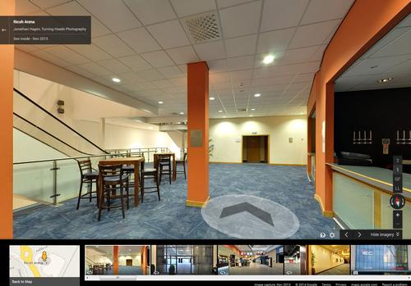
Augmented reality indoor navigation app
Team blueprints
Justus Karenzi
Sudi Nsengiyumva
Jeremy Fischer
Jordan Ziegler
Dylan Shanahan

Slide 2
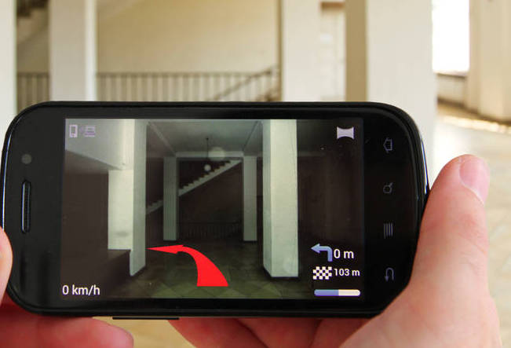
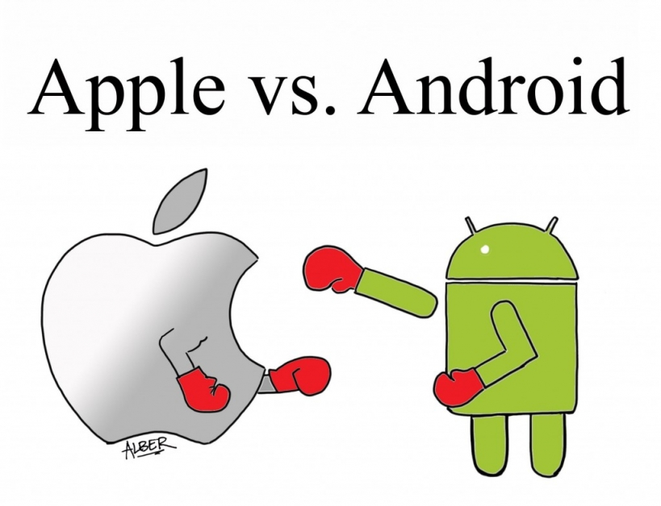

Initial Problem Statement
The App will rely on Augmented reality

Slide 3



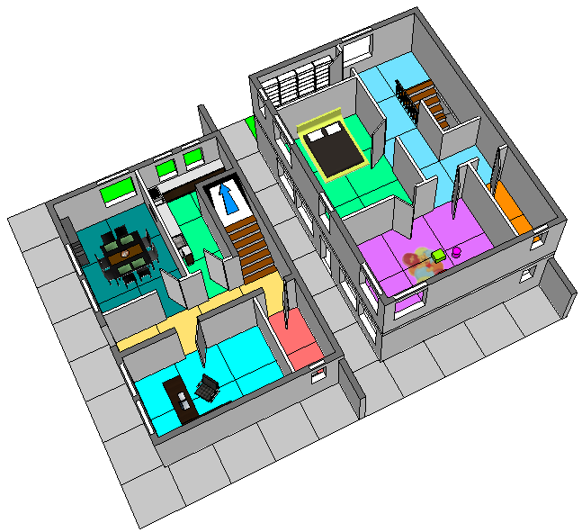
Client Interview
Hello Navi is a possible resource for Augmented manipulation
The team is free to choose between IOS and Android
The Application should be user friendly
Inserting a map of the building and include a 3D guide from room to room

Slide 4

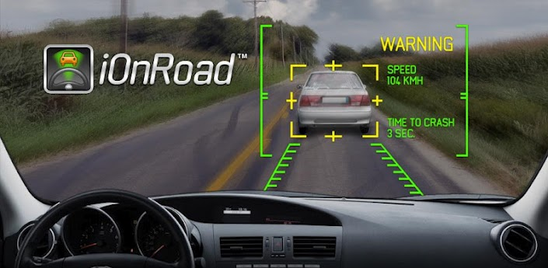

Background Research and Relevant Technology
Available technologies for designing navigation applications
iOnRoad is a free augmented reality driving safety app

Slide 5
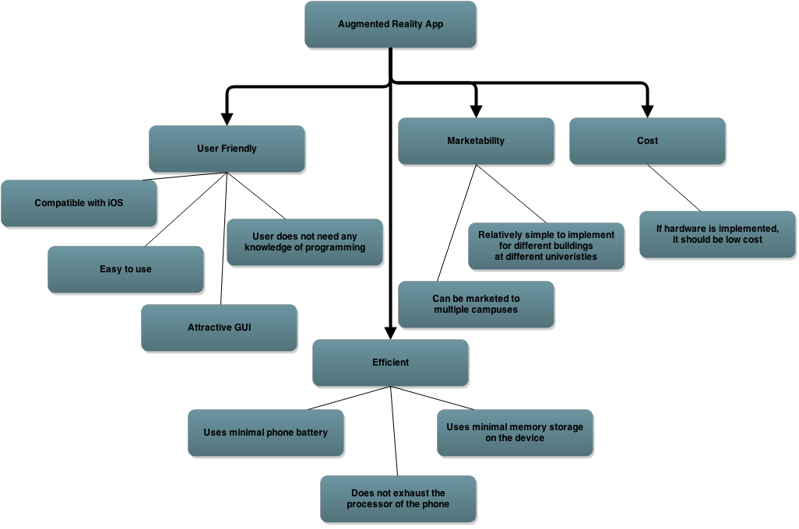
Objectives Tree

Slide 6
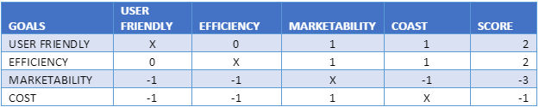
Comparison Chart
-1: The goal in the row is less important than the goal in the column.
0: The goal in the row is equally important to the goal in the column.
1: The goal in the row is more important than the goal in the column.
x: Cannot compare goal relative to itself

Slide 7


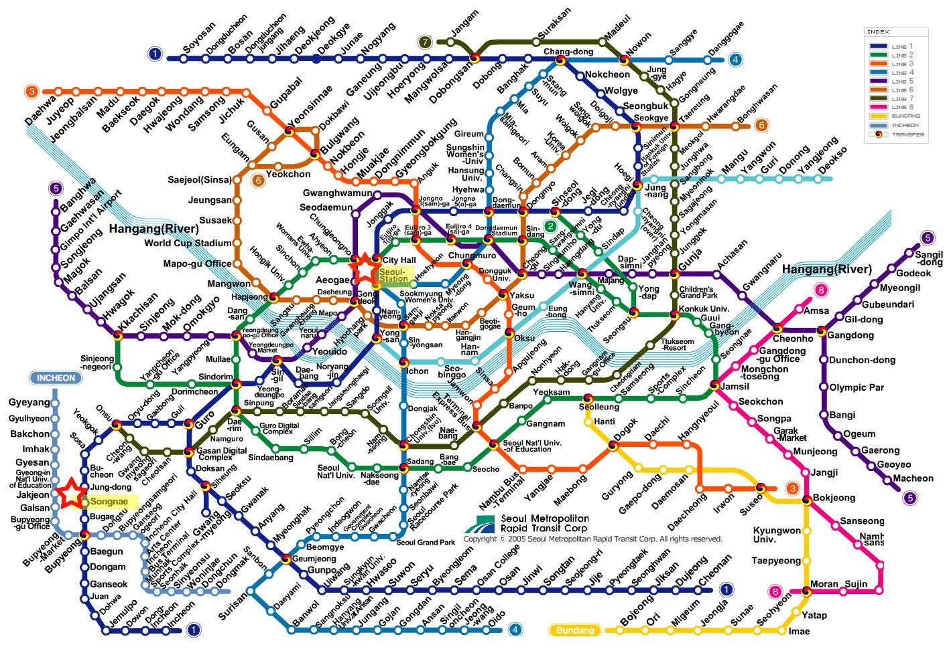
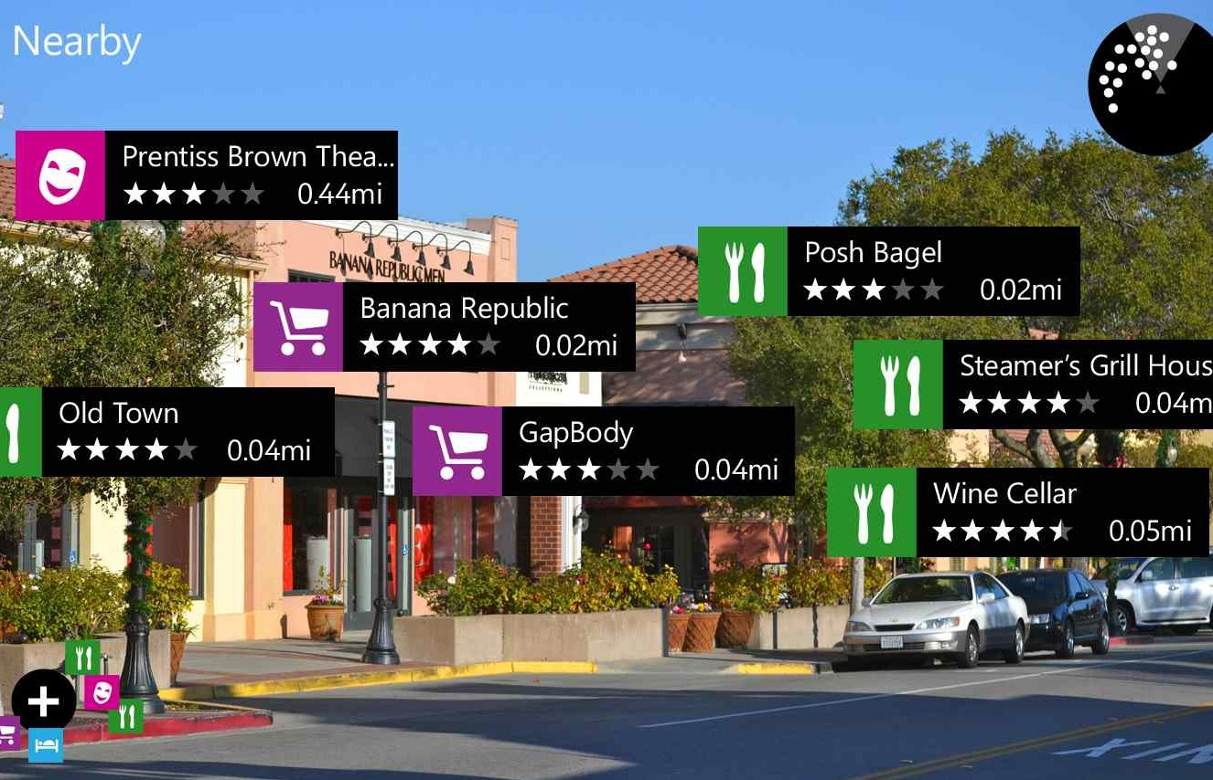
Problem Definition

Slide 8
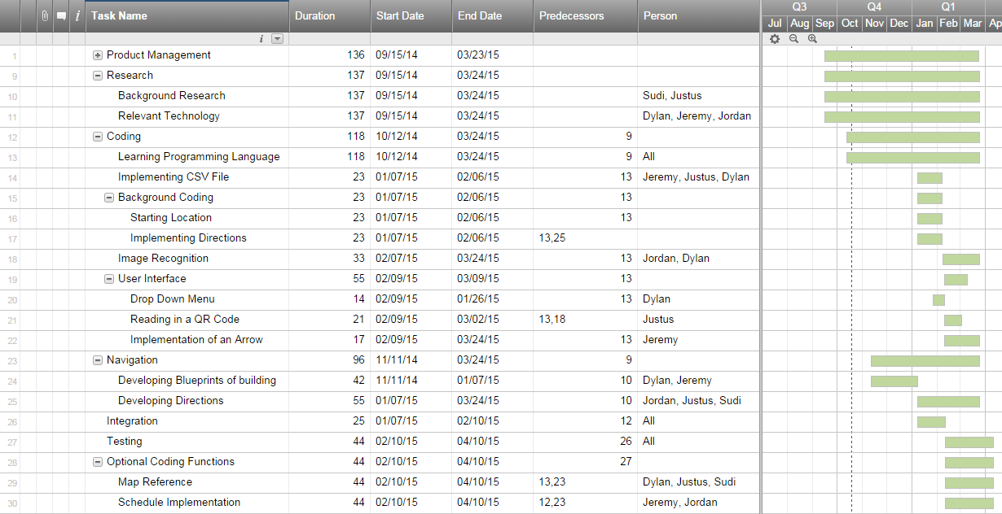
Gantt Chart

